Slide 1


Understanding cancer phenomena using a thermodynamic-based approach
(GBM) tumors
Using information theory to predict cancer patient specific drug combinations
Nataly Kravchenko-Balasha
The Hebrew University of Jerusalem

Slide 2
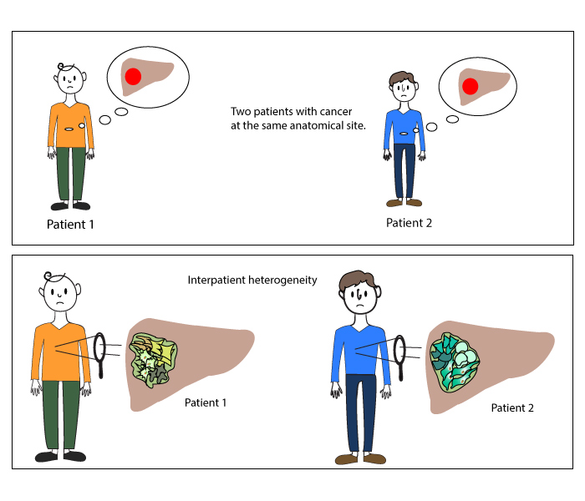
Inter-patient heterogeneity

Slide 3
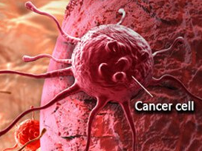
Scale-free
protein-protein network
Hub proteins
proteins in the network
Protein network is comprised of signal transduction pathways in which proteins communicate
one with another and can can affect the activity of each other

Slide 4

Information-theoretic analysis of inter-patient heterogeneity
Protein-protein network
∆G = ∆H - T∆S
EGFR
HER
deviation
G
∆G
StS (STEADY STATE)
tumor 1
balanced state
unbalanced process
EGFR
HER
cMet
Muc1
Ecad
tumor 2
Analysis of deviations from the steady state will allow to predict how the imbalance can be reduced

Slide 5
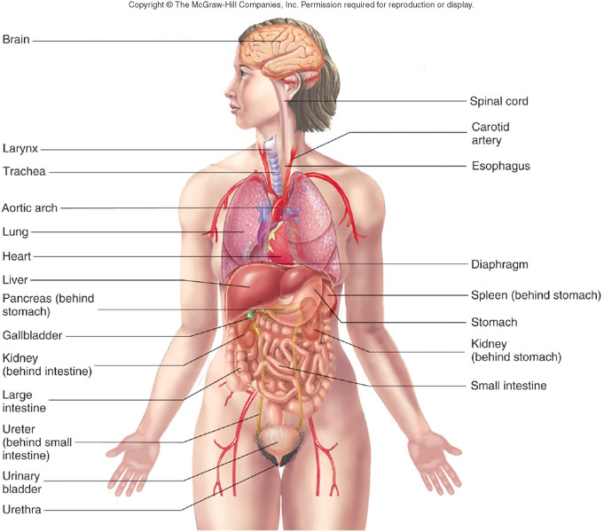
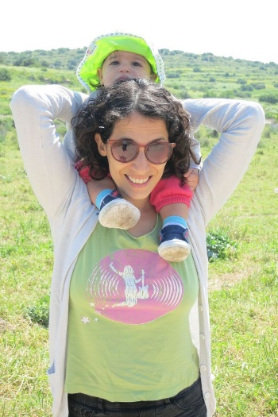
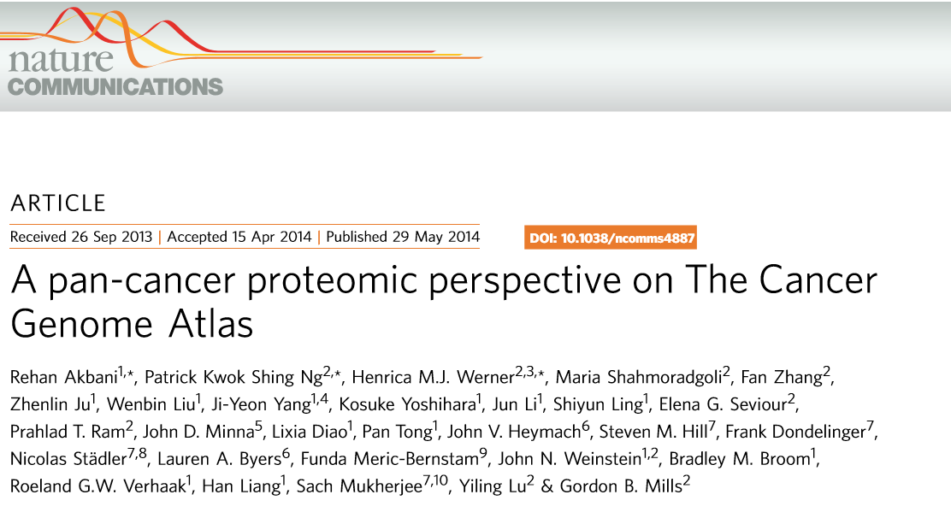
3467 tumors of 11 types
n = 215
Head and neck
n = 212
adenocarcinoma: n = 237
squamous cell carcinoma:
n = 195
Skin
Blood
Breast
n = 747
n = 454
Rectum
n = 130
n = 334
Ovary
n = 412
n = 127
Uterus
n = 404
Dr. Efrat Flashner-Abramson

Slide 6
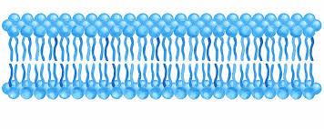
181 cancer-associated proteins and phosphoproteins
extracellular space
EGFR
VEGFR2
E-cadherin
Her2
cytoplasm
MAPK
p53
Src
Akt
NFkB
ERα

Slide 7
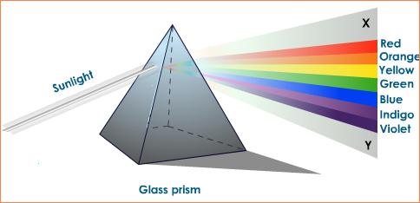
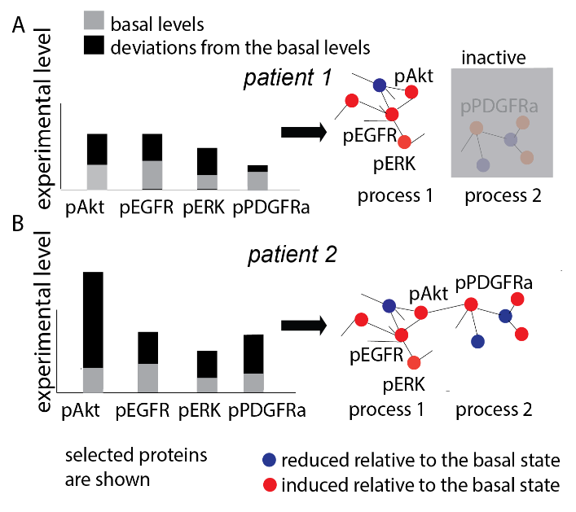
Towards personalized medicine
We analyzed a large proteomic dataset which has been obtained from 3467 patients, harboring tumors of 11 different types (brain, breast, etc.).
Towards personalized medicine

Slide 8
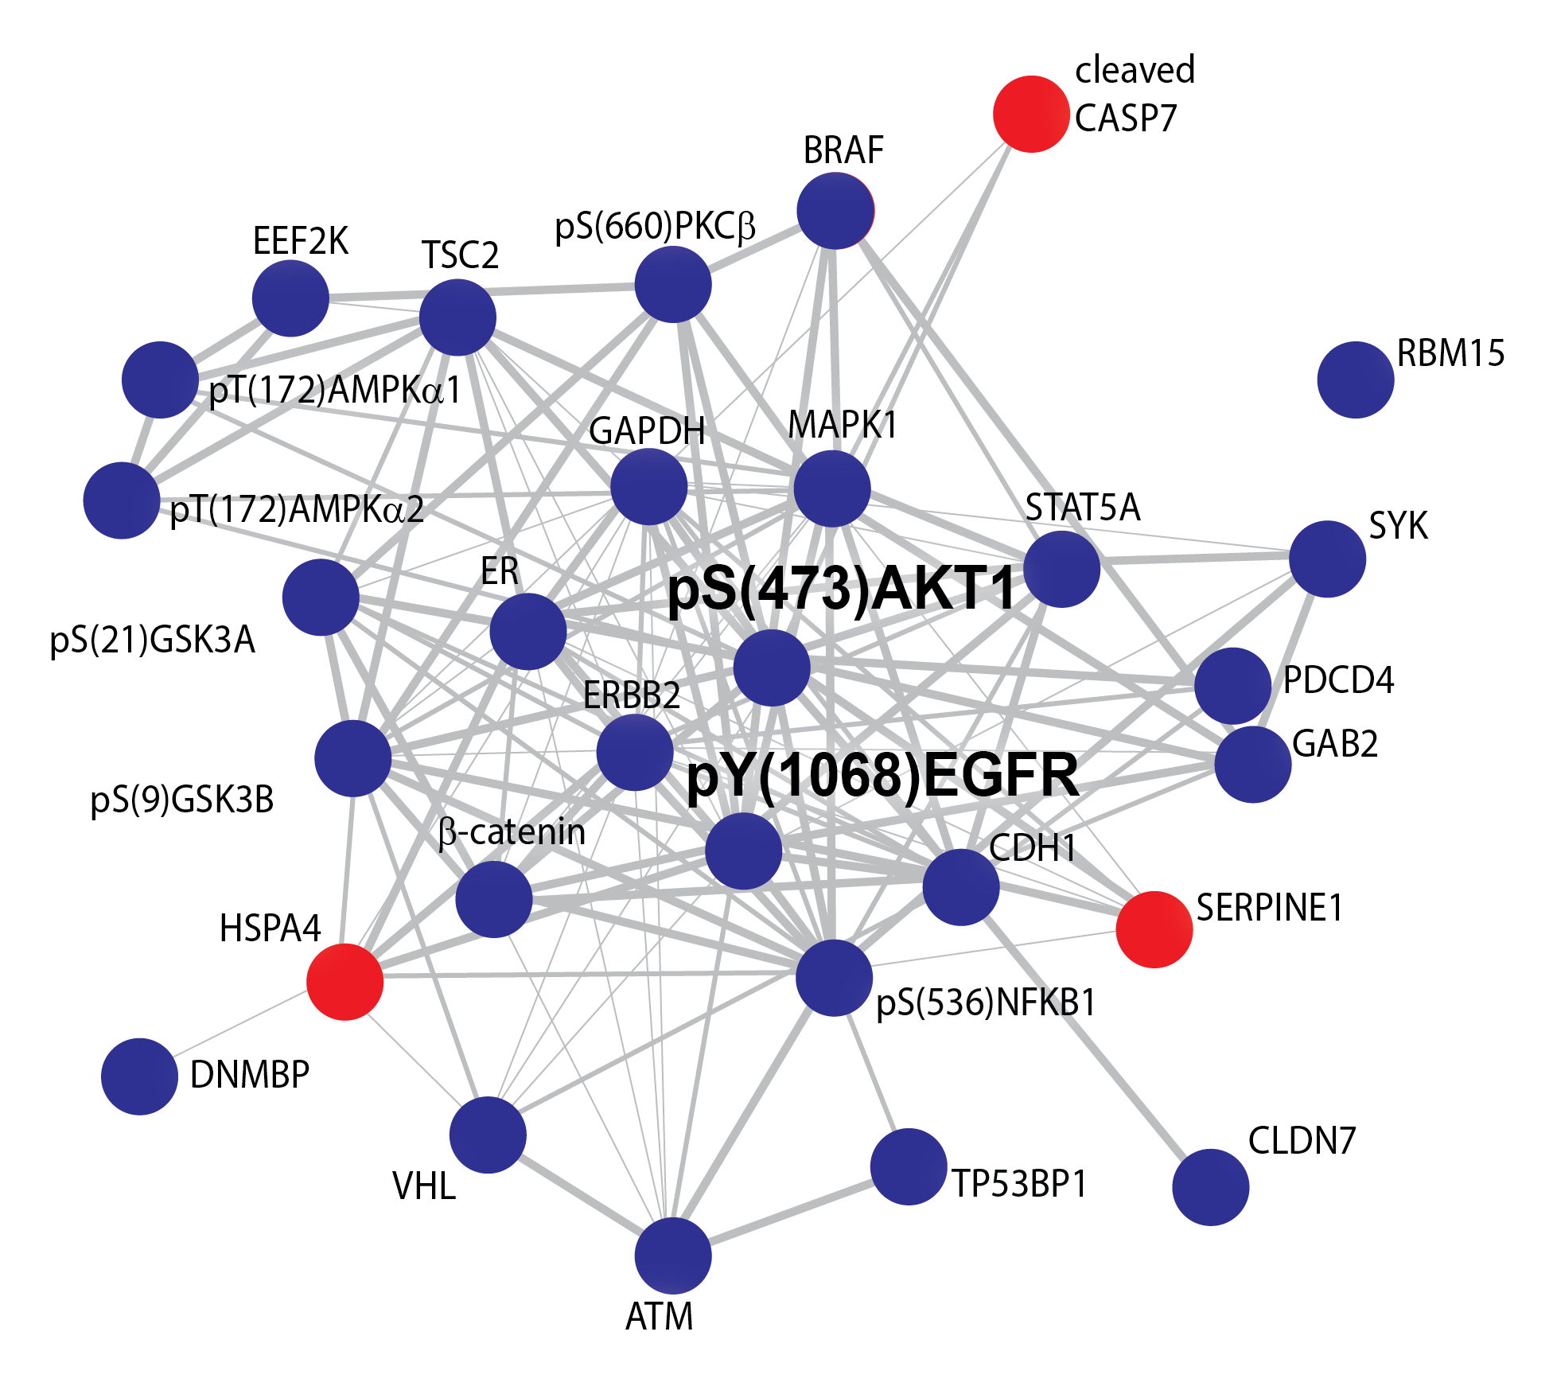
17 unbalanced processes are enough to describe 3467 tumors
Unbalanced process 4
Unbalanced process 5
Unbalanced process 1
anti-correlation
each tumor harbors a subset of 1-4 processes

Slide 9
Unbalanced process 4
Unbalanced process 5
Unbalanced process 1
anti-correlation
Patient TCGA BA-6872
Patient TCGA BP-4760
Head and neck carcinoma
Kidney renal carcinoma
#1, 5
#1, 4
Log₂ (fold change
of experimental levels)
Log₂ (fold change
of experimental levels)

Slide 10
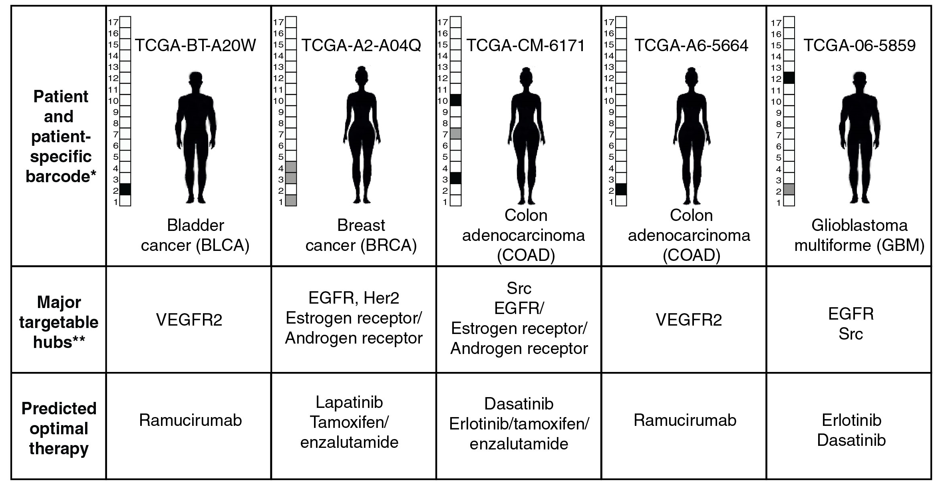
Towards personalized medicine : designing patient-specific drug combinations
452 unique barcodes were found in this dataset. This result suggests that the dataset consists of 452 types of cancer, rather than only 11!
Suggested
therapy

Slide 11
Predicting effective drug targets in breast cancer cell lines:
Cell-specific imbalances
and suggested inhibitors
The unbalanced network in MDA-MB-231
4OHT- tamoxifen
Resolution of unbalanced networks provides predictions for personalized treatments

Slide 12
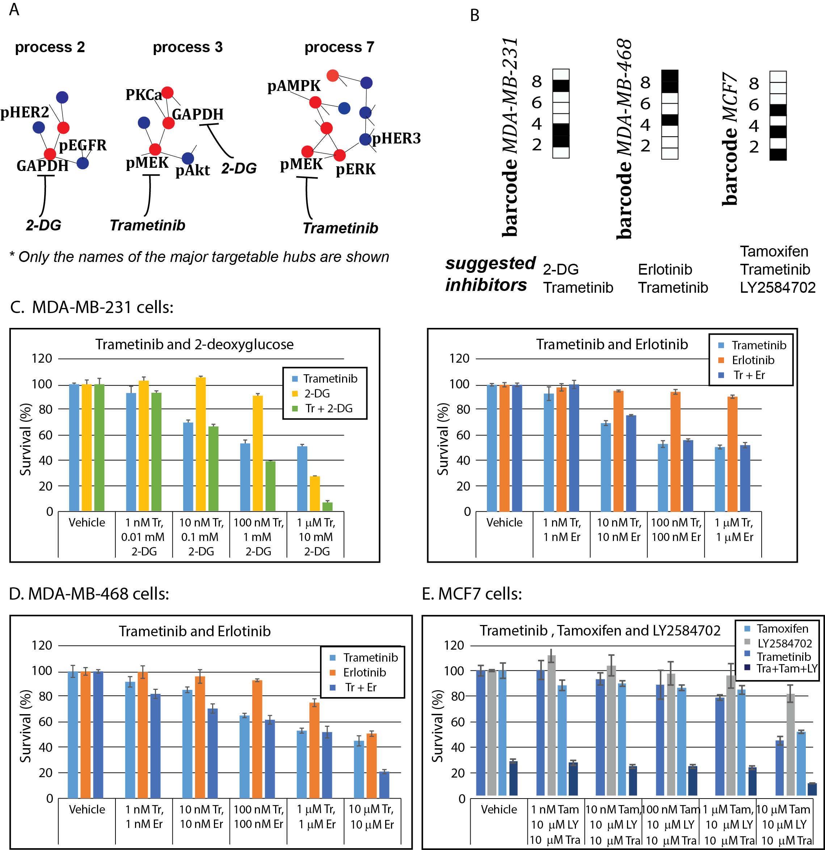
Experimental validation
Our predictions indeed worked efficiently, even in triple negative breast cancer cell lines,
for which targeted therapy is currently unavailable.

Slide 13
Experimental validation
MDA-MB-231 breast cancer triple negative cells
The predicted combination works more efficiently than the therapy existing in clinics

Slide 14
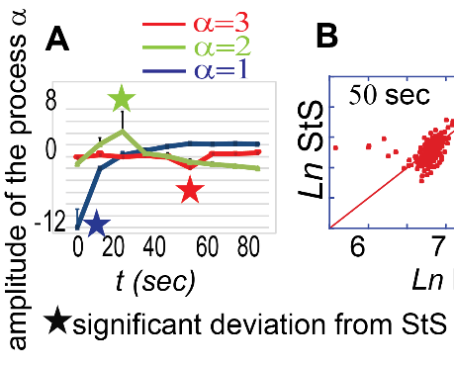
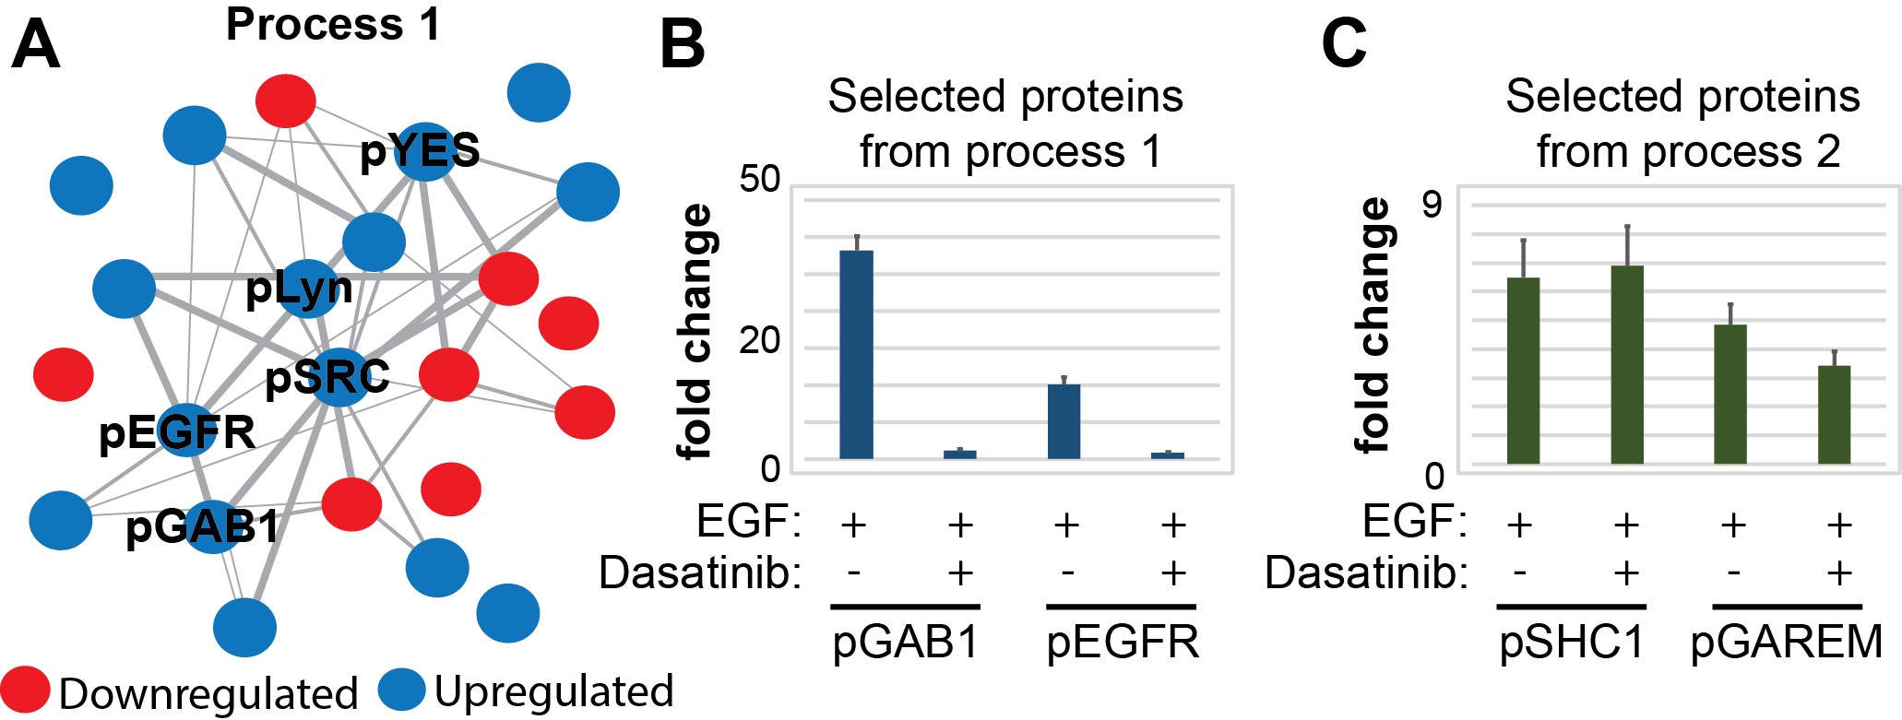
Recently we validated the approach in MCF10A immortalized cells:
3. The accurate resolution of unbalanced networks enables the prediction of drug response Using surprisal analysis of the changes in the levels of ~200 tyrosine-phosphorylated proteins in response to EGF we resolved an unbalanced network structure that occurred in immortalized breast MCF10A cells
We confirmed the accuracy of the analysis through the inhibition of the central hubs from the unbalanced process 1- the Src family proteins with Dasatanib.
This result confirms the independence of the processes and suggests that in order to reduce the entire imbalance in the system, central proteins from all unbalanced processes should be inhibited.
collaboration with Forest M. White, MIT (Efrat Flashner-Abramson et al., Chemical Physics, in press)

Slide 15
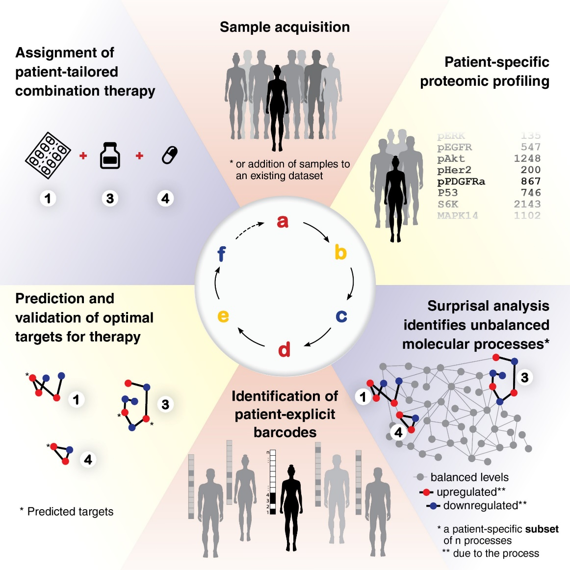
Summary: Towards personalized medicine
Take- home message
Towards personalized medicine: Once the information from multiple patients is transformed into a low-dimensional space, we can provide patient-specific unbalanced network structures. These structures can be used to rationally design patient specific drug therapies.

Slide 16
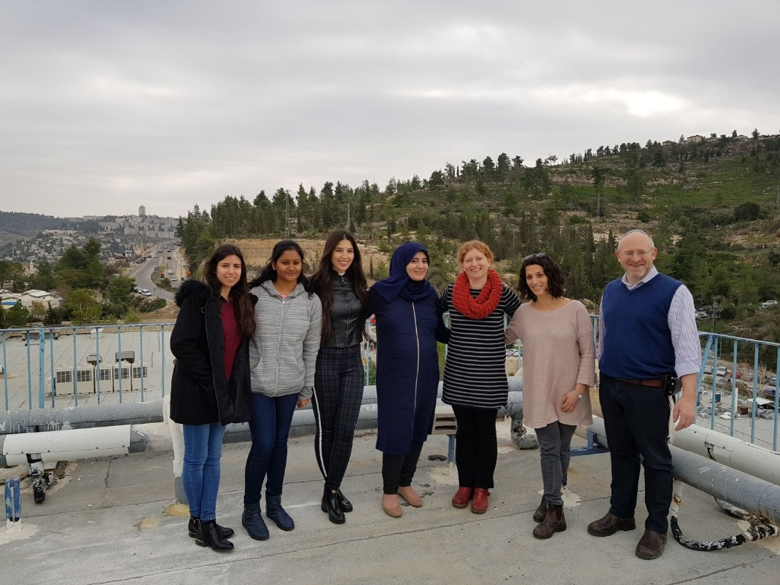
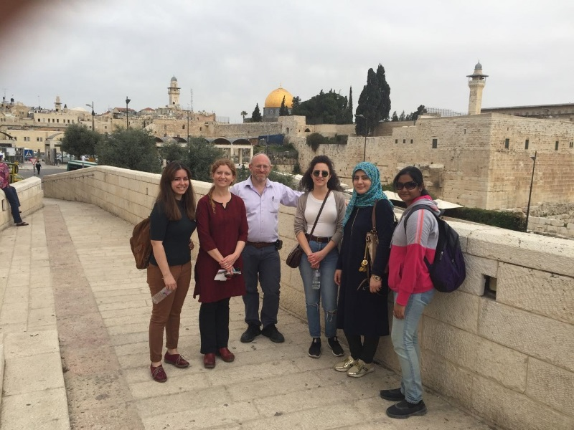



Acknowledgements
Members of my lab at the Hebrew University:
Dr. ARIEL M. RUBINSTEIN
Dr. EFRAT FLASHNER-
ABRAMSON
SWETHA VASUDEVAN
ROSHINA THAPA
HEBA ALKHATIB
MARIA JUBRAN
HILA DAGAN
David Nathanson, UCLA
Forest M. White, MIT, U.S.
Amir Sonnenblick, Hadassah Hospital
Carlos Caldas, Cancer Research UK
Cambridge Institute
Thank you !!!!
Dr. Izador I. Cabakoff Research Endowment Fund
Antoinette E. and Herman
Boehm Foundation

Slide 17
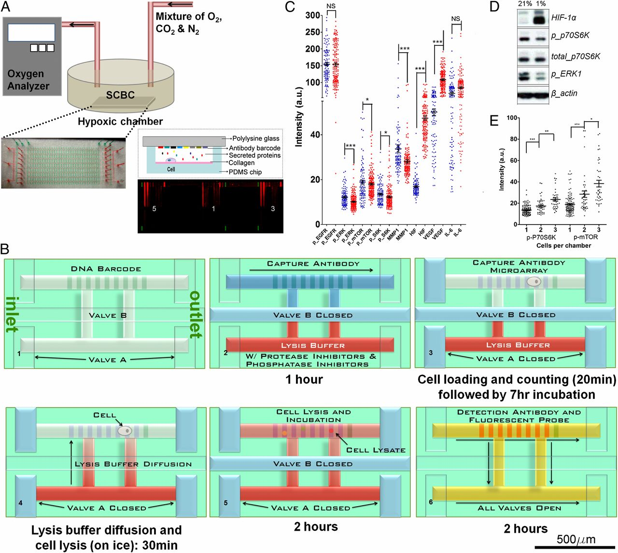
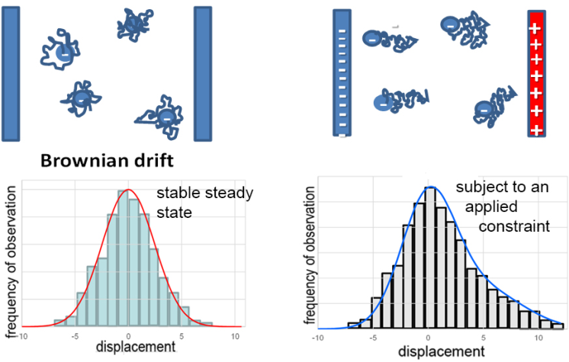
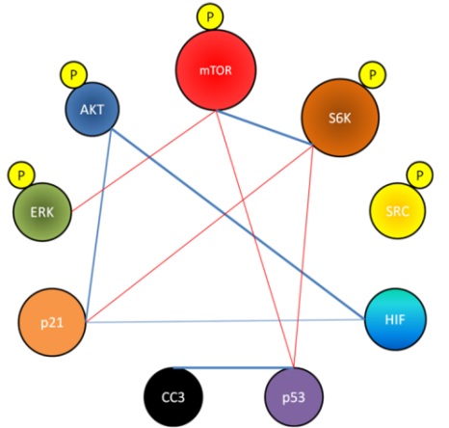
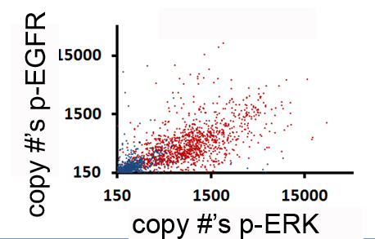
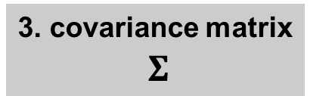
Analysis of variations in protein levels
15000
1500
protein concentration
# of biological samples
150
pEGFR concentration
pEGFR concentration
pEGFR
Akt
anti-correlations
2. Identify protein-protein relationships
EGFR
S6K
correlations
p21
ERK
p53
3. covariance matrix
$Σ$
pEGFR concentration
4. Use the matrix to identify biological states of the system
pERK concentration

